Slide 1
A Study of infection Control-Covid-19 Course Registrars
By:Abdulaziz Wali

Slide 2


Slide 3

Introduction
What happened in last of 2019 ?
In what they want from me help ?

Slide 4

meetings Brief
Register:
Sunday 29 December/2019
-
Thursday 04 April/2020
Specific Station – 13 Station
Work time in :
12:00:00 AM-08:00:00 AM

Slide 5
The Register
From 2000/1
8858 registered

Slide 6
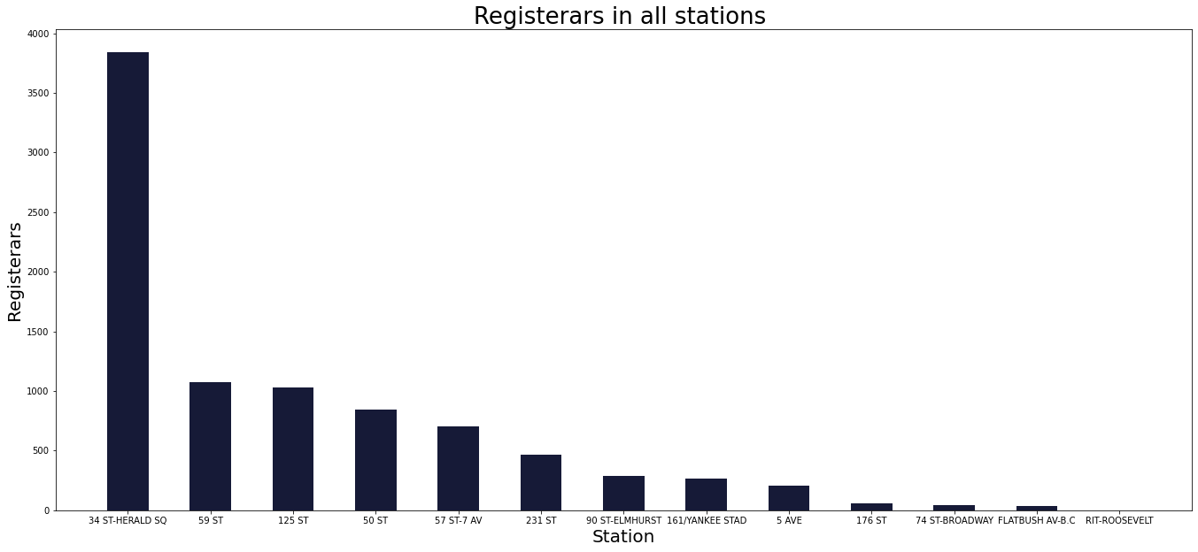
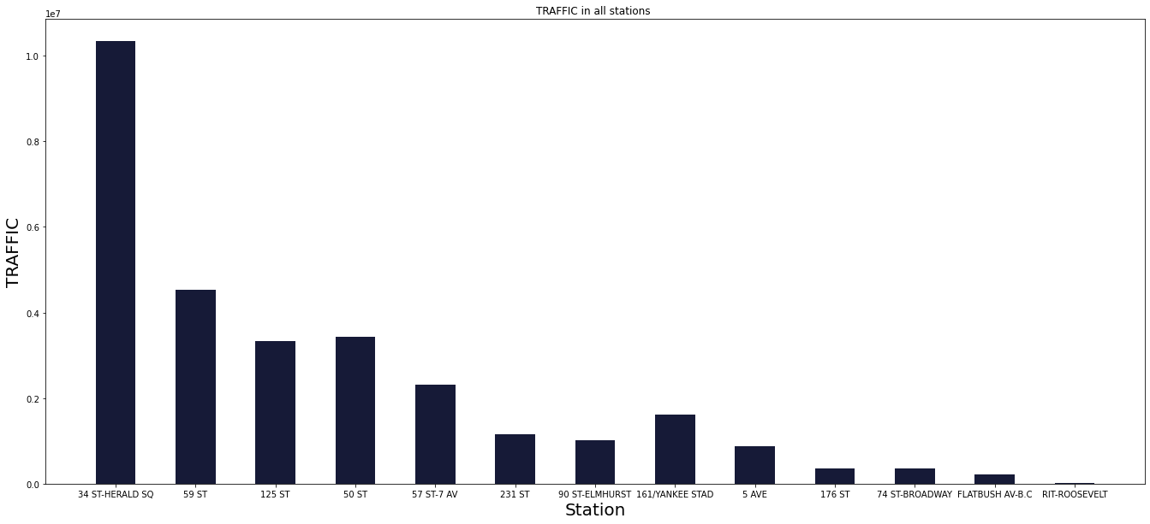
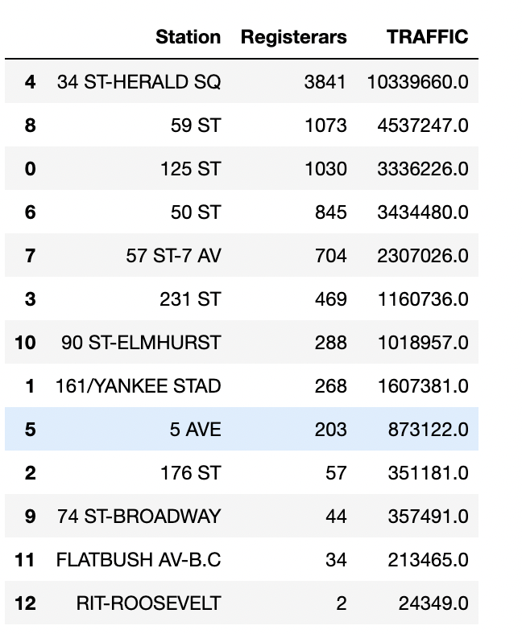
Statistic-1

Slide 7
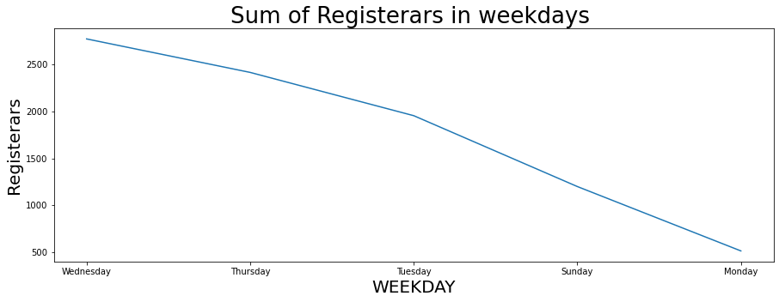
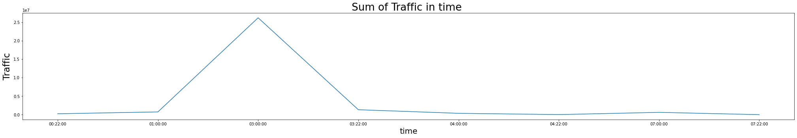
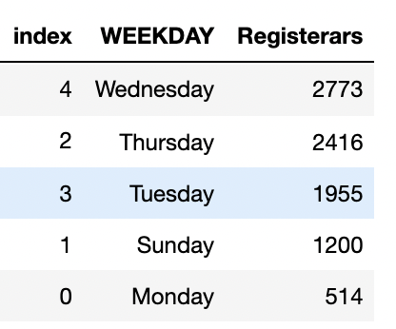
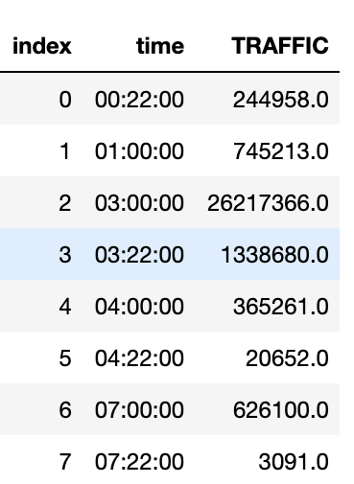
Statistic-2

Slide 8
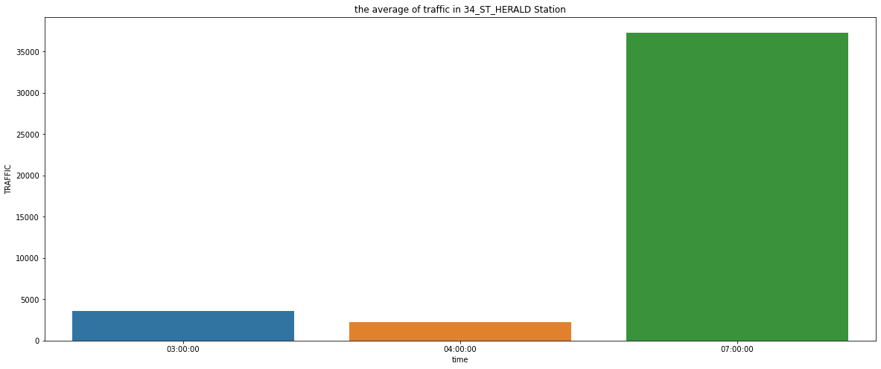
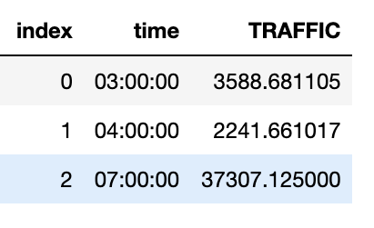
Statistic-3

Slide 9
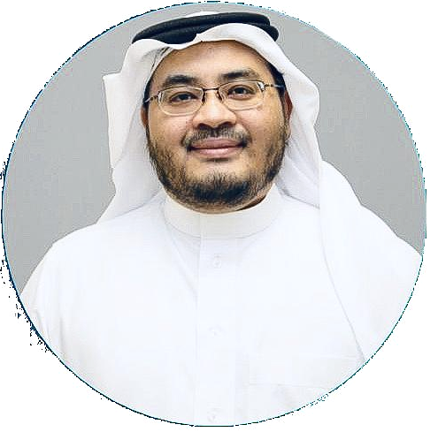
Recommendation
darb.almfaz@gmail.com
Avoid crowded times and days-
1AM
3AM
7AM
place the largest number of workers in 34 St - Herald Sq Station
Contracting with ASA Collage

Slide 10
Thank You

